Slide 1
Routing

Slide 2
Traditional Routing
Learning switches
Link-state routing
Dijkstra’s Algorithm
Distance-vector routing
Bellman-Ford

Slide 3
Basics of Routing and Forwarding

Slide 4
Example of Network Graph
Router with 6 attached links
Router with 4 attached links

Slide 5
A Variety of Networks
ISPs: carriers
Backbone
Edge (connecting to customers)
Border (to other ISPs)
Enterprises: companies, universities
Core
Edge (connecting to hosts)
Border (to outside)
Datacenters: massive collections of machines
Aggregation and Core
Top-of-Rack
Border (to outside)

Slide 6
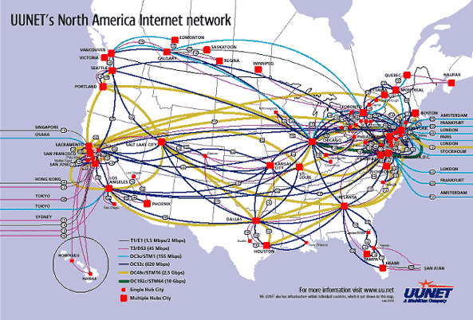
UUNET’s North American Network
Notes:
Very irregular

Slide 7
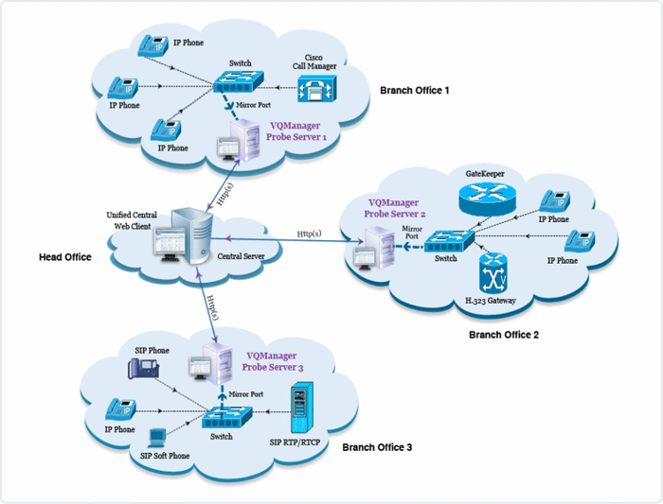
Enterprise Network
Notes:
Not very detailed, couldn’t get a better one….

Slide 8
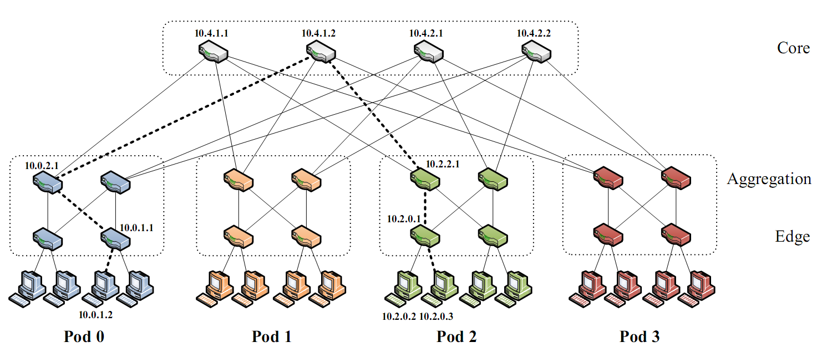
Partial Datacenter Network
Notes:
Only a part of the network, but the takeaway is that the network is very regular, involving levels of hierarchy.

Slide 9
Switches
Enterprise/Edge: typically 24 to 48 attached links
Aggregation switches: 192 or more
Backbone: typically fewer attached links
Border: typically very few attached links

Slide 10
Destination-Based Routing
Paths from two different sources (to same destination) must coincide once they overlap
Notes:
Why coincide?

Slide 11
Destination-Based Routing
Paths to same destination never cross
Once paths to destination meet, they never split
Set of paths to destination create a “delivery tree”
Must cover every node exactly once
Spanning Tree rooted at destination
Notes:
You all know what a spanning tree is?

Slide 12
A “Delivery Tree” for a Destination

Slide 13
Assume Destination-Based Routing
For rest of lecture (and course)…..

Slide 14
Validity of Routing State

Slide 15
Local and Global Routing State
Local routing state is the state in a single router
By itself, the state in a single router can’t be evaluated
It must be evaluated in terms of the global context
Global routing state means collection of routing state in each of the routers
Global state determines which paths packets take
Will discuss later where this routing state comes from

Slide 16
“Valid” Routing State
Global routing state is “valid” if it produces forwarding decisions that always deliver packets to their destinations
Valid is my terminology, not standard
Goal of routing protocols: compute valid state
But how can you tell if routing state if valid?
Need a succinct correctness condition for routing
Suggestions?
Notes:
What could go wrong?

Slide 17
Necessary and Sufficient Condition
Global routing state is valid if and only if:
There are no dead ends (other than destination)
There are no loops
A dead end is when there is no outgoing port
A packet arrives, but the forwarding decision does not yield any outgoing port
A loop is when a packet cycles around the same set of nodes forever

Slide 18
Wandering Packets
Packet reaches deadend and stops
Packet falls into loop and never reaches destination

Slide 19
Necessary and Sufficient Condition
Global routing state is valid if and only if:
There are no dead ends (other than destination)
There are no loops

Slide 20
Necessary (“only if”): Obvious
If you run into a deadend before hitting destination, you’ll never reach the destination
If you run into a loop, you’ll never reach destination
With deterministic forwarding, once you loop, you’ll loop forever (assuming routing state is static)

Slide 21
Sufficient (“if”): Easy
Assume no deadends, no loops
Packet must keep wandering, without repeating
If ever enter same switch from same port, will loop
Because forwarding decisions are deterministic
Only a finite number of possible ports for it to visit
It cannot keep wandering forever without looping
Must eventually hit destination
Notes:
Destination is only safe deadend

Slide 22
Checking Validity of Routing State
Focus only on a single destination
Ignore all other routing state
Mark outgoing port with arrow
There can only be one at each node
Eliminate all links with no arrows
Look at what’s left….

Slide 23
Example 1

Slide 24
Pick Destination

Slide 25
Put Arrows on Outgoing Ports

Slide 26
Remove Unused Links
Leaves Spanning Tree: Valid

Slide 27
Second Example

Slide 28
Second Example
Is this valid?

Slide 29
Lesson….
Very easy to check validity of routing state for a particular destination
Deadends are obvious
Node without outgoing arrow
Loops are obvious
Disconnected from rest of graph

Slide 30
Computing Routing State

Slide 31
Forwarding vs Routing
Forwarding: “data plane”
Directing a data packet to an outgoing link
Individual router using routing state
Routing: “control plane”
Computing paths the packets will follow
Routers talking amongst themselves
Jointly creating the routing state
Two very different timescales….
Forwarding: single packet transmission times: μs
Routing: can be seconds
6 orders of magnitude!

Slide 32
The “Secret” of Routing
Avoiding deadends is easy
Avoiding loops is hard
The key difference between routing protocols is how they avoid loops!
Don’t focus on details of mechanisms
Just ask “how are loops avoided?”
Notes:
Most modern routing research is about how to make the loop-freeness a more fundamental part of the algorithm. In what I’m going to present today, it is only loop-free AFTER convergence. That’s not good enough

Slide 33
How Can You Avoid Loops?
Easiest way: Restrict topology to spanning tree
If the topology has no loops, packets can’t loop!
(without making a u-turn, which can be locally prevented)

Slide 34
Routing on Spanning Tree

Slide 35
Easiest Way to Avoid Loops
Use a topology where loops are impossible!
Take arbitrary topology
Build spanning tree (algorithm covered later)
Ignore all other links (as before)
Only one path to destinations on spanning trees
So don’t have to worry about loops!

Slide 36
Consider previous graph

Slide 37
A Spanning Tree

Slide 38
Another Spanning Tree

Slide 39
Yet Another Spanning Tree

Slide 40
Routing on a Spanning Tree
There is only one path from source to destination
How do you find that path?
Why bother? Just send packets along all paths
No packets will loop, but some will hit deadends
But one (and exactly one) will reach destination

Slide 41
Flooding on a Spanning Tree
If you want to send a packet that will reach all nodes, then switches can use the following rule:
Ignoring all ports not on spanning tree!
Originating switch sends “flood” packet out all ports
When a “flood” packet arrives on one incoming port, send it out all other ports

Slide 42
Flooding on Spanning Tree

Slide 43
Flooding on Spanning Tree (Again)

Slide 44
Flooding on a Spanning Tree
This works because the lack of loops prevents the flooding from cycling back on itself
Eventually all nodes will be covered, exactly once

Slide 45
But isn’t flooding wasteful?
Yes, but you can watch the packets going by, and learn from that
There is a single path between any two nodes
If node A sees a packet from node B come in on a particular port, what can it conclude?
It knows what port to use to reach B!

Slide 46
Nodes can “learn” routing tables
Switch can learn how to reach nodes by remembering where flooding packets came from!
If flood packet from Node A entered switch from port 4, then switch uses port 4 to reach Node A

Slide 47
Learning from Flood Packets
Node A can be reached
through this port
Node A can be reached
through this port
Node B
Node A
Once a node has sent a flood message, all other switches know how to reach it….

Slide 48
Node B Responds
Node B can be reached
through this port
Node B can be reached
through this port
Node B can be reached
through this port
Node B can be reached
through this port
Node B
Node A
When a node responds, some of the switches learn where it is

Slide 49
General Approach
Flood first packet to node you are trying to reach
All switches learn where you are
When destination responds, some switches learn where it is…
Only some switches, because packet to you follows direct path, and is not flooded
The decision to flood or not is done on a switch-by-switch basis….

Slide 50
Self-Learning Switch
When a packet arrives
Inspect source ID, associate with incoming port
Store mapping in the switch table
Use time-to-live field to eventually forget mapping
Packet tells switch how to reach A.
B
A
C
D

Slide 51
Self Learning: Handling Misses
When packet arrives with unfamiliar destination
Forward packet out all other ports
Response will teach switch about that destination
B
A
C
D

Slide 52
General Rule
When switch receives a packet:
index the switch table using destination ID
if entry found for destination {
if dest on port from which packet arrived then drop packet
else forward packet on port indicated
}
else flood
Why do this?
forward on all but the interface
on which the frame arrived

Slide 53
Summary of Learning Approach
Avoids loop by restricting to spanning tree
This makes flooding possible
Flooding allows packet to reach destination
And in the process switches learn how to reach source of flood
No route “computation”

Slide 54
Weaknesses of This Approach?
Requires loop-free topology (Spanning Tree)
Must eliminate many links from physical topology
Reducing bisection bandwidth (jargon)
Very little control over paths (traffic engineering)
Slow to react to failures
Tree must be recomputed
Slow to react to host movement
Entries must time out
Spanning Trees suck (just ask an operator)

Slide 55
On to other routing techniques…
How do we compute loop-free routes in arbitrary topologies?
Suggestions?

Slide 56
Avoiding Loops
Central computation
Can make sure no loops
Minimizing metric in distributed computation
Loops are never the solution to a minimization problem
(for well-behaved metrics)

